Slide 1
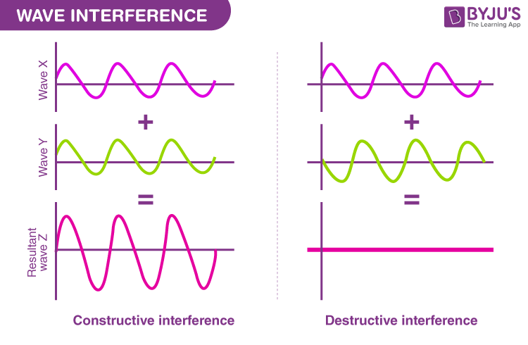
Final Project - Synthetic radargrams
This code generate a synthetic radargram from a fracture model with increasing aperture in R+
The model includes a heterogeneity.
Using ggplot, it was plotted the maximum of amplitude vs trace. There is a remarkable zone of constructively interference, as reported by Tsoflias (2001) and Widess (1973).

Slide 2
ModelEarthTracesHeterogeneous.csv
Dielectric constant= 6.0
Dielectric constant= 9.0
Dielectric constant= 80.0
“Water saturated”
1.2 m
Dielectric constant= 6.0

Slide 3
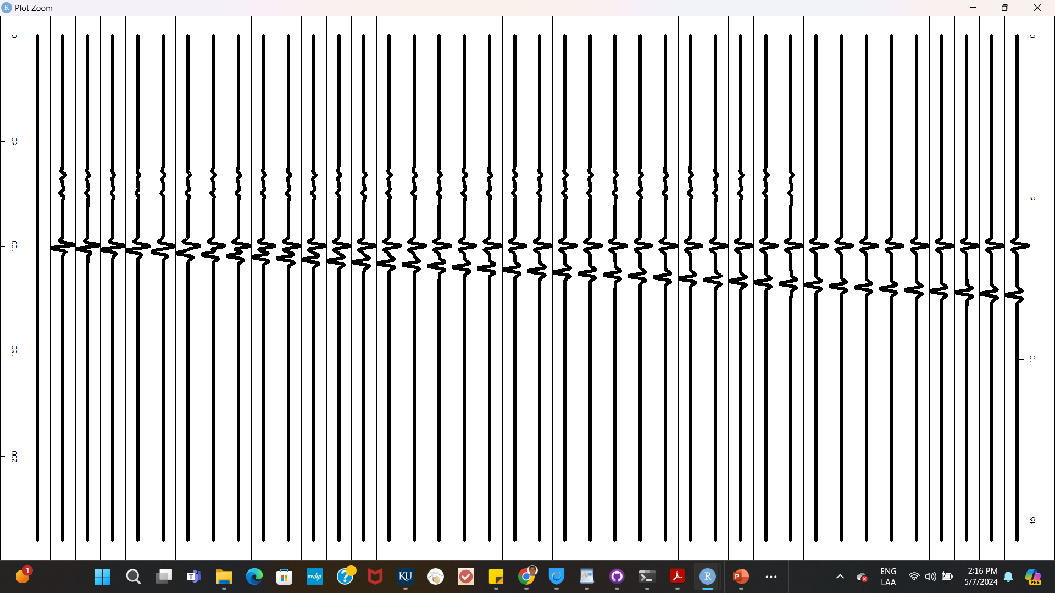
Non-related
Reflectors
Depht (m)
Time (ns)
Trace number

Slide 4
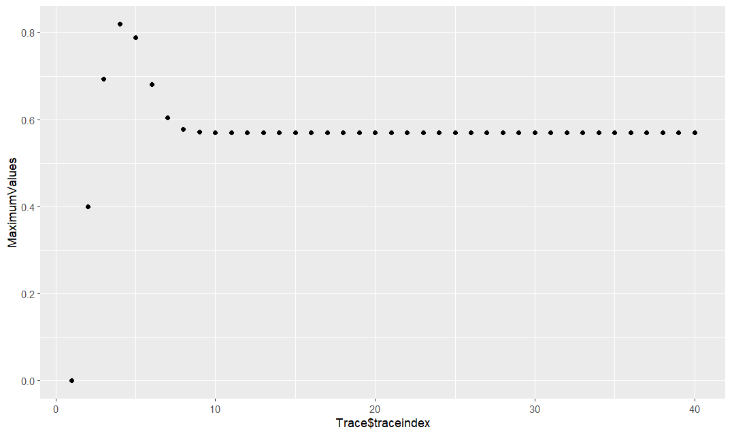
Variation of amplitude vs fracture aperture
Constructively interference zone
The trace 1 has a 0.0 aperture. Each trace towards the right represents, approximately,
an increase of 3 cm in aperture

Slide 5
Conclusions
Non-related reflections do not affect amplitude response of the fracture due to zero-offset assumption for each trace. 3D modelling would have a real picture of the effects of spurious events in the propagation of radar signals (dispersion – attenuation).

Slide 6
Successful modeling of amplitude effects vs aperture. Follow up work varying frequency and wavelet would produce ideas about the potential of radar from predicting fracture aperture in rocks.

